Slide 1
More Laws & Principles
IT 467
https://www.interaction-design.org/literature/article/hick-s-law-making-the-choice-easier-for-users

Slide 2
Content
Hick’s Law and the KISS principle

Slide 3
Overview of Hick’s Law
The time it takes to make a decision increases with the number and complexity of choices.

Slide 4
Hick’s Law
Hick’s Law (or the Hick-Hyman Law) is named after a British and an American psychologist team of William Edmund Hick and Ray Hyman.
In 1952, this pair set out to examine the relationship between the number of stimuli present and an individual’s reaction time to any given stimulus.
The more stimuli to choose from, the longer it takes the user to make a decision on which one to interact with. Users bombarded with choices have to take time to interpret and decide, giving them work they don’t want.
https://www.interaction-design.org/literature/article/hick-s-law-making-the-choice-easier-for-users

Slide 5
Hick’s Law
Where “RT” is the reaction time, “(n)” is the number of stimuli present,
and “a” and “b” are arbitrary measurable constants that depend on the task that is to be carried out and the conditions under which it will be carried out.
RT = a + b log2 (n)

Slide 6
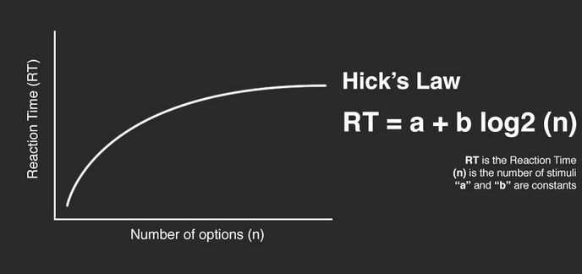

Slide 7
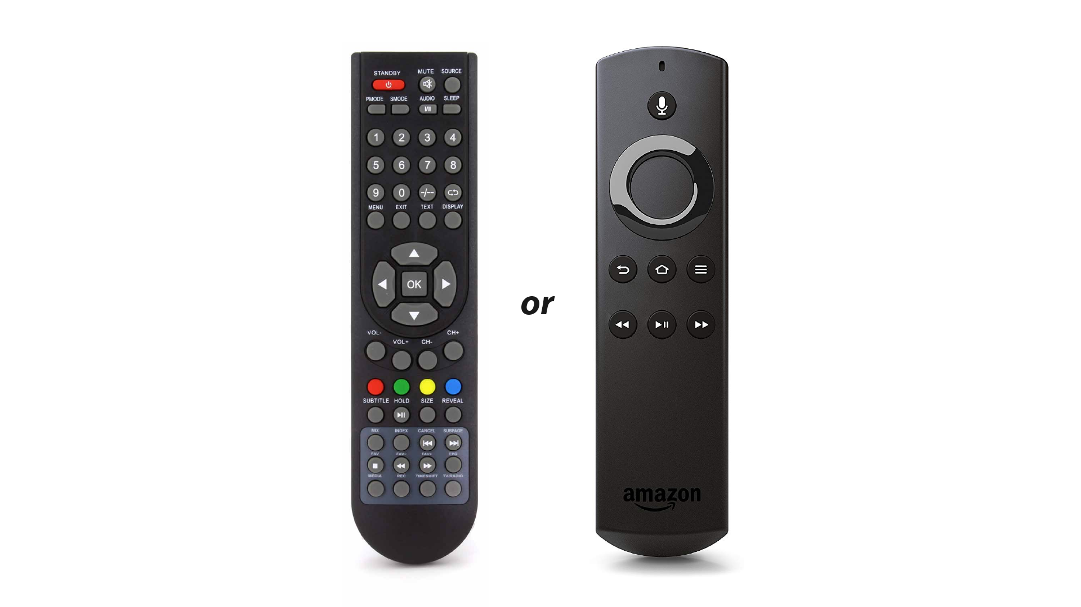
Notes:
https://uxdesign.cc/do-you-know-the-law-that-makes-or-breaks-a-ux-designer-hicks-law-6f2651400663

Slide 8
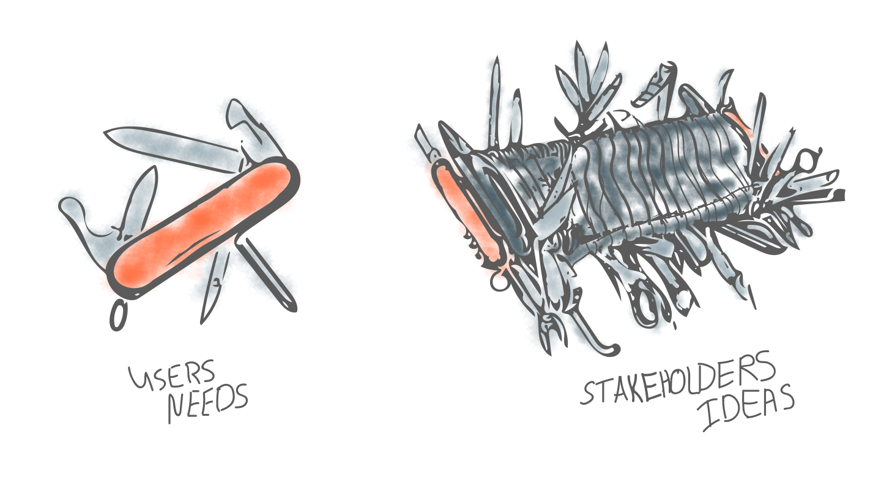

Slide 9
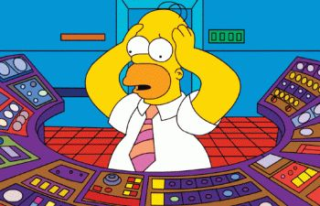

Slide 10
What we can do
To enhance the user experience, we should consider the following:
Categorizing Choice – Enabling users to find items from higher categories, as if they were looking under sections in a library.
Obscuring Complexity – Breaking up long or complex processes into screens with fewer options.

Slide 11


Slide 12
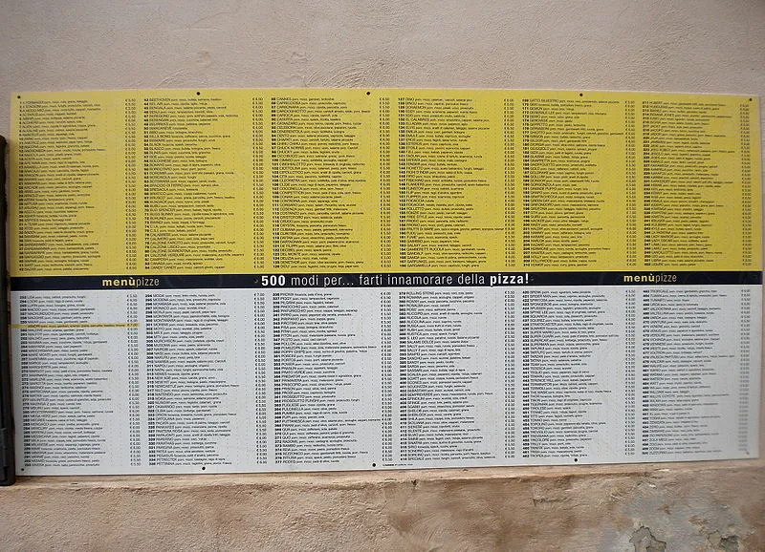

Slide 13
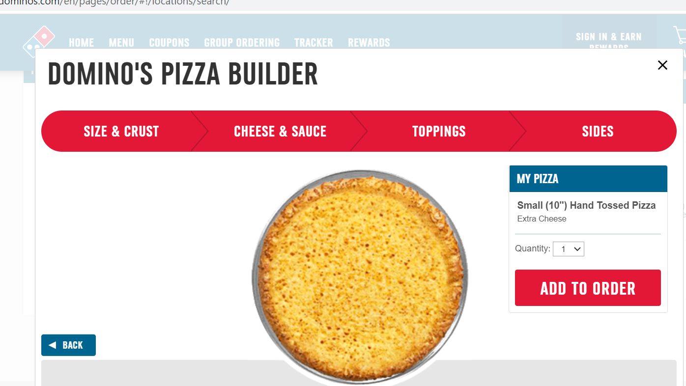

Slide 14
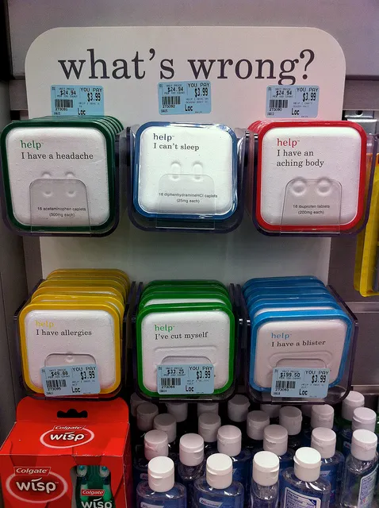
The KISS Principle (Keep It Simple, Stupid)
https://uxplanet.org/design-principles-kiss-the-feature-creep-7eb84b09603f#.p2f9m3ct4
Notes:
The KISS principle is related to the Hick’s law.
Definition: The KISS principle is defined as a design principle that suggests that most systems work best if they are kept simple and straightforward. KISS principle or Keep it Simple, Stupid was popularly used in the 1970s.

Slide 15
Origin of Keep it Simple Stupid Principle
In the US Navy in 1960, Kelly Johnson had formulated the KISS principle while working as an engineer for the Lockheed Skunk Works, Lockheed Martin’s advanced aircraft program for different combat conditions.
Johnson has founded the KISS principle during a long engineering career of designing systems using simple tools and skills.
Notes:
The KISS Principle - Keep it Simple, Stupid | Marketing91

Slide 16
The KISS Principle
Whilst simplicity is an admirable goal and can lead to enhanced user experiences, it is important not to let simplicity interfere with the design objective.
The user must still be able to carry out their task requirements with the finished products or the design process has failed – no matter how simple the final design.
https://www.interaction-design.org/literature/article/kiss-keep-it-simple-stupid-a-design-principle
Notes:
Adobe xd

